Slide 1
WELCOME

Slide 2
Book Store Management System
Presented by-
Gayatri Dighe

Slide 3
Introduction
This system is created for Book Store Managers to handle sale of books.
This application helps managers to acquire information of books available in store,
Book Store Managers can ADD , DELETE and MODIFY the information of books with this System.

Slide 4
SoftwareRequirements:
ECLIPSE IDE

Slide 5
Modules:
There are four modules in this system.
Admin:
This includes information about admins userId and password.
BookData:
Includes info about Books . Some values of books are hard coded in this program.
BooksAdding:
Includes methods to add Books in store management system.
MajesticStore: This includes main method.

Slide 6
Functions :
Following are the modules used in this system:
showMenu()
Shows menu of operation that can be done in this system.
showBook()
Shows books available in store.
addBook()
Admin can add books in system using this module.

Slide 7
modBook()
This function helps in modifying information about books
e.g: number of copies and price of book.
deleteBook()
If book is sold out Using this function admin can delete that book.

Slide 8
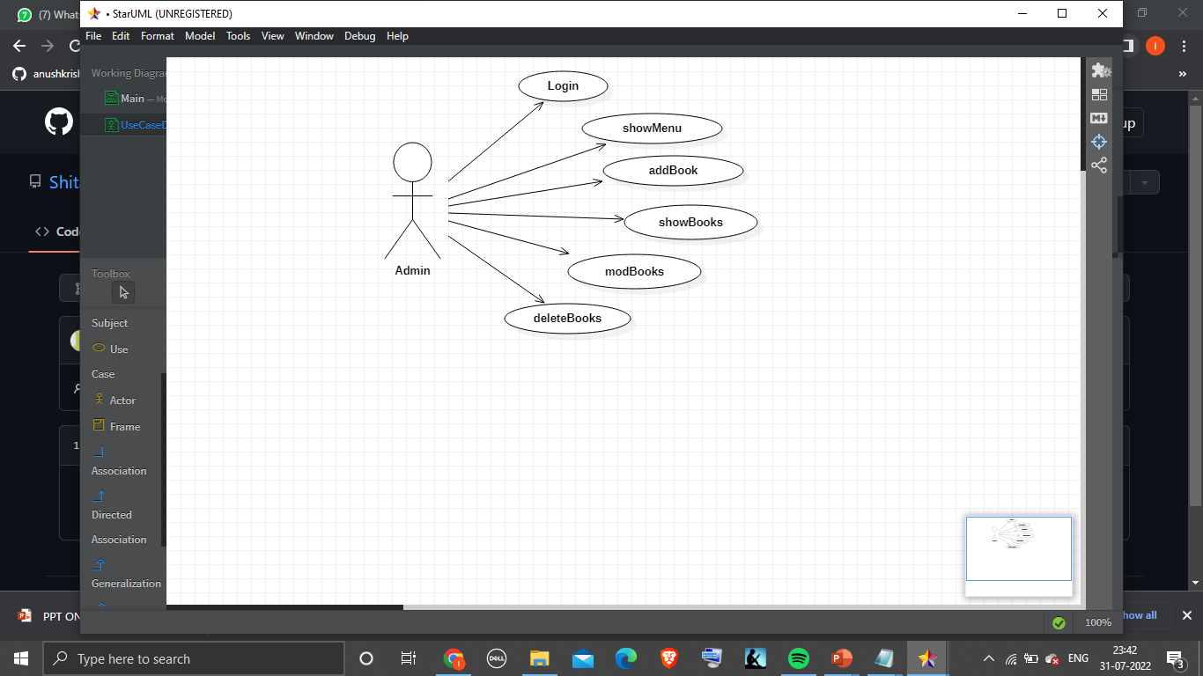
UseCase Diagram:

Slide 9
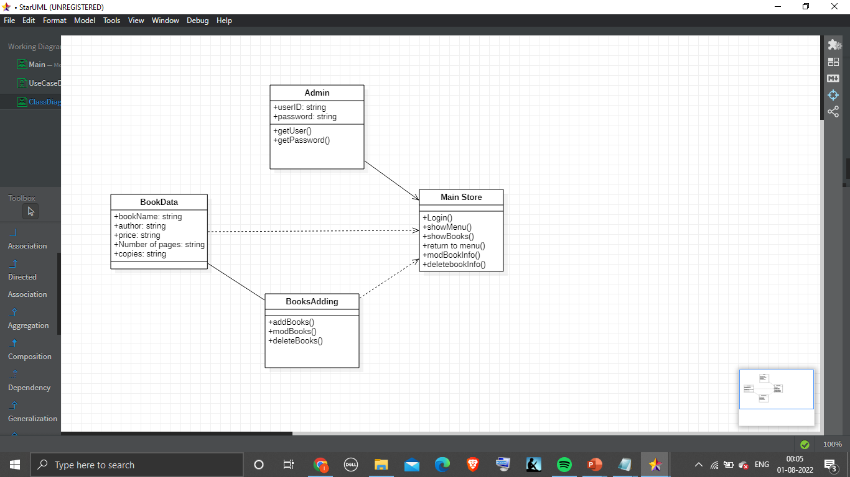
Class Diagram

Slide 10
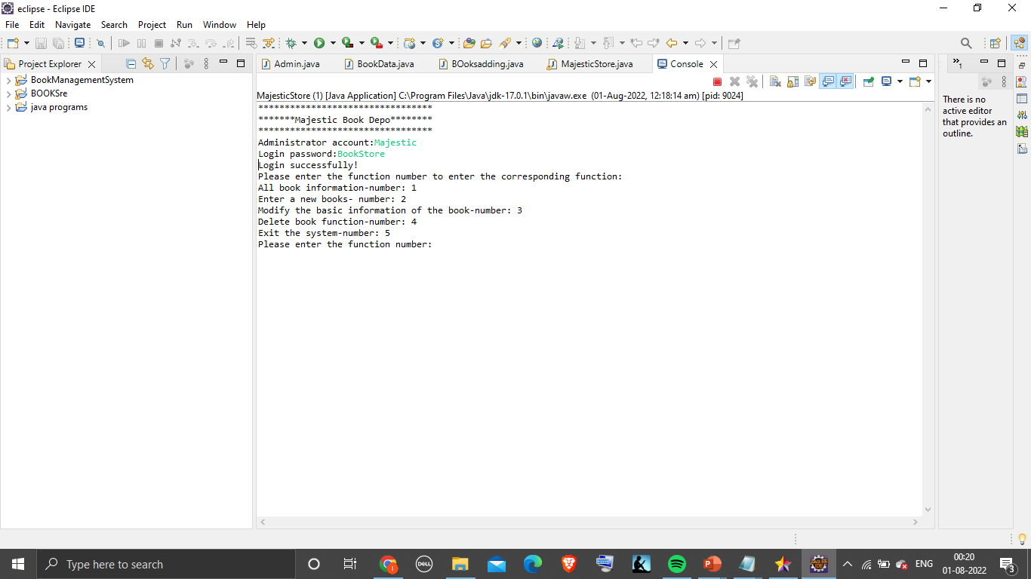
Successfully Logged into system.

Slide 11
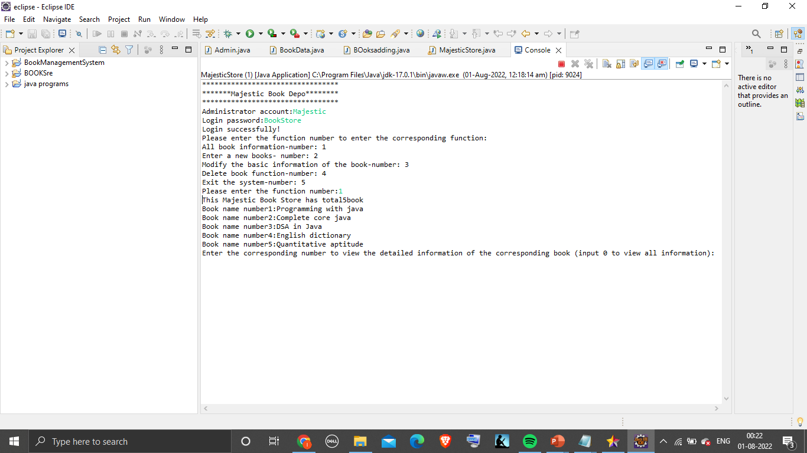
showMenu() function

Slide 12
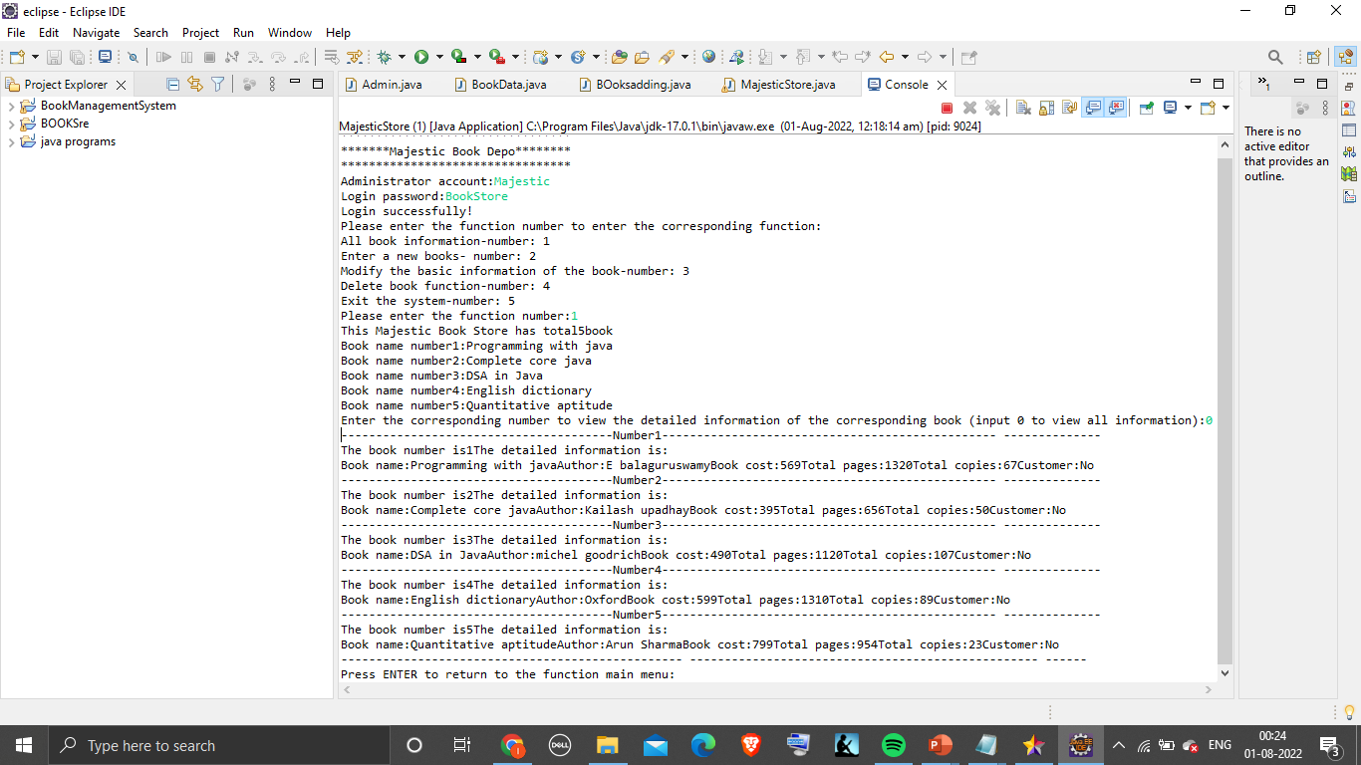
showBook() Function

Slide 13
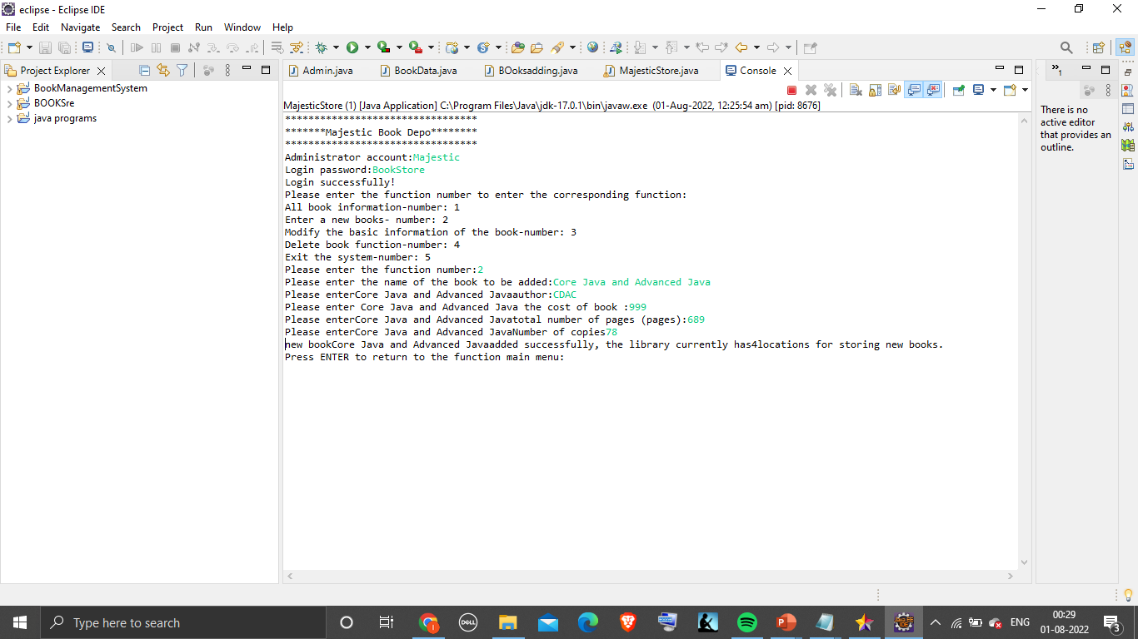
addBook() function

Slide 14
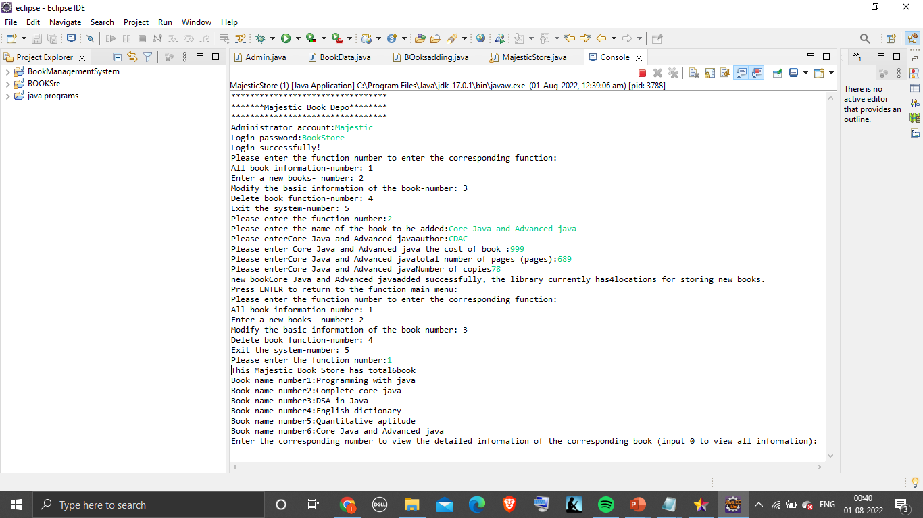
Book added Successfully

Slide 15
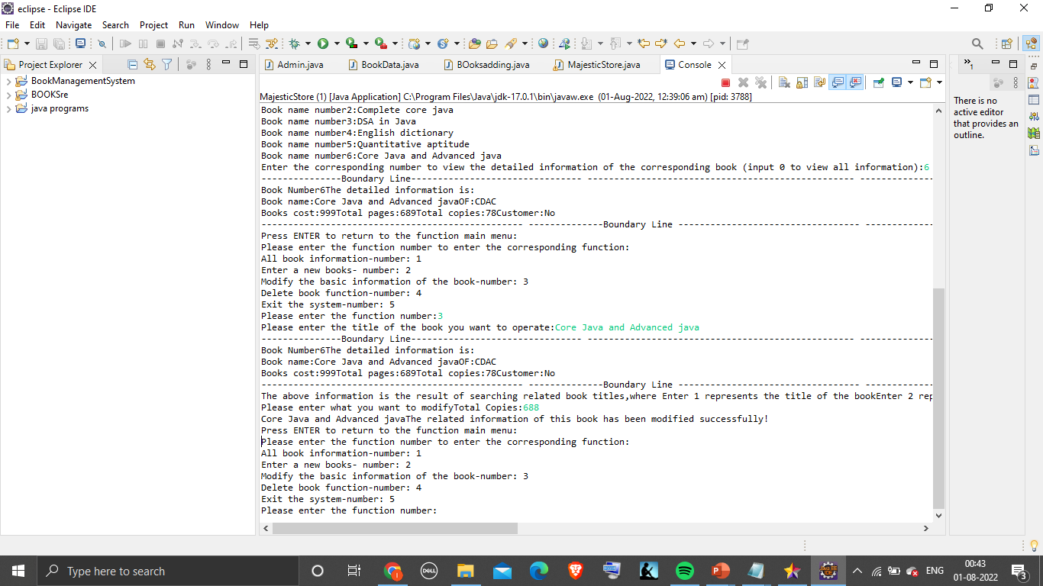
modBook() function modified no of copies available

Slide 16
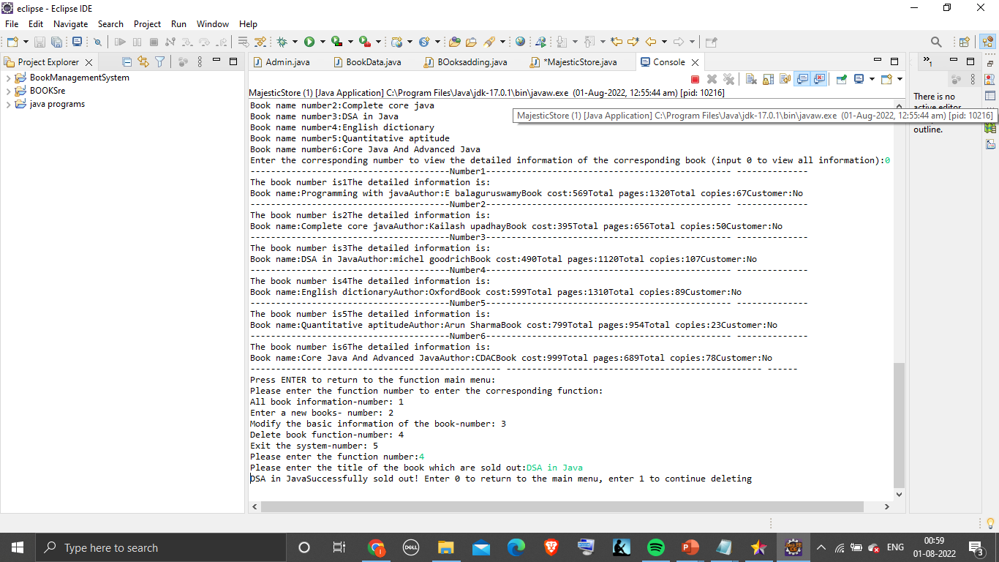
DeleteBook() Deletes book

Slide 17
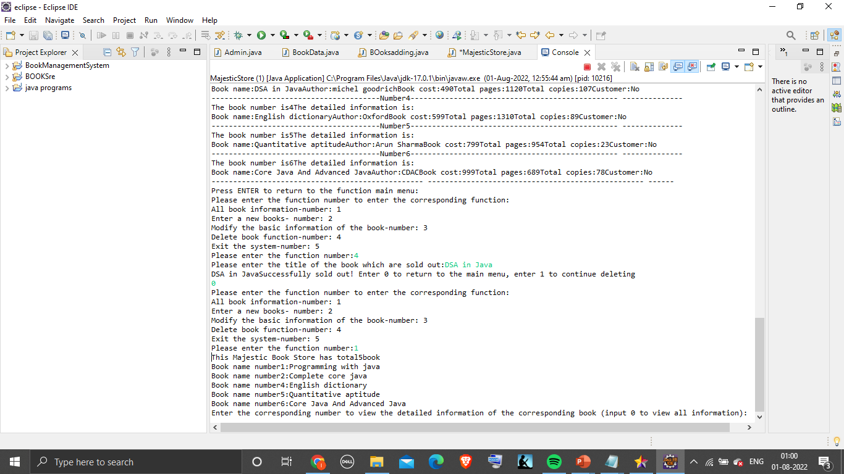
Book deleted Successfully represents in total book list

Slide 18
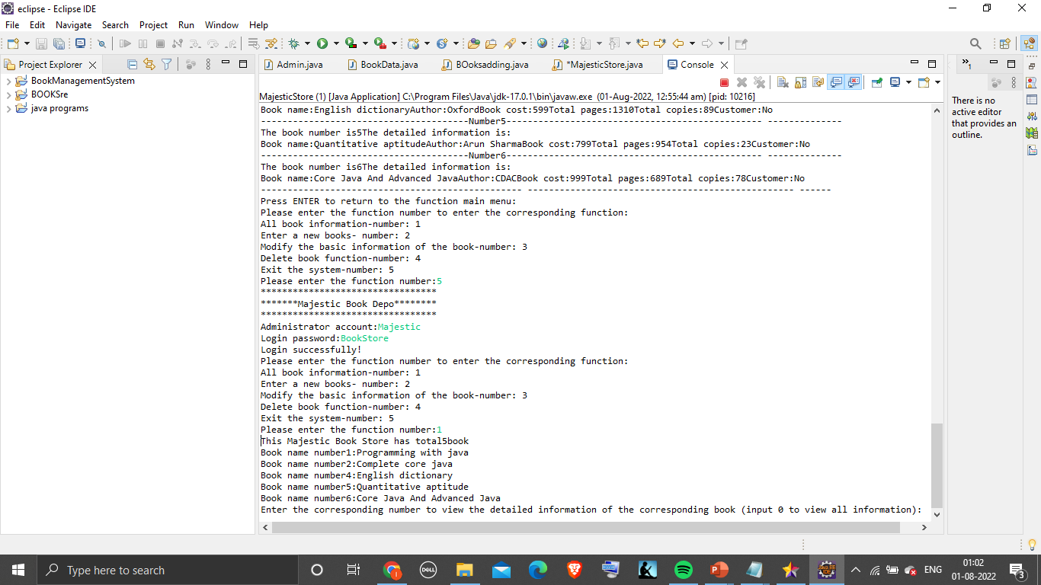
Successful Logout Changed Information retained after loging in again

Slide 19
Future goals for this System
A customer module can be added which will let customers create a login ID and password using this they can view available books and price.
A module in which customer can add books to cart before book is available in store, so they do not have to take tension about book selling out.
A module where customer can sell off there old books to book store.

Slide 20
Resources
www.google.com
www.javatpoint.com/arrays
www.youtube.com
www.projectIdeas.com

Slide 21


